Slide 1

X-Reporto
Slogan…………………………….

Slide 2

TABLE OF CONTENTS
01
02
03
04
01
05
05
06
Problem
Motivation
Market
Our Tool
07
08
Modules
Challenges
Workload
Timeline

Slide 3
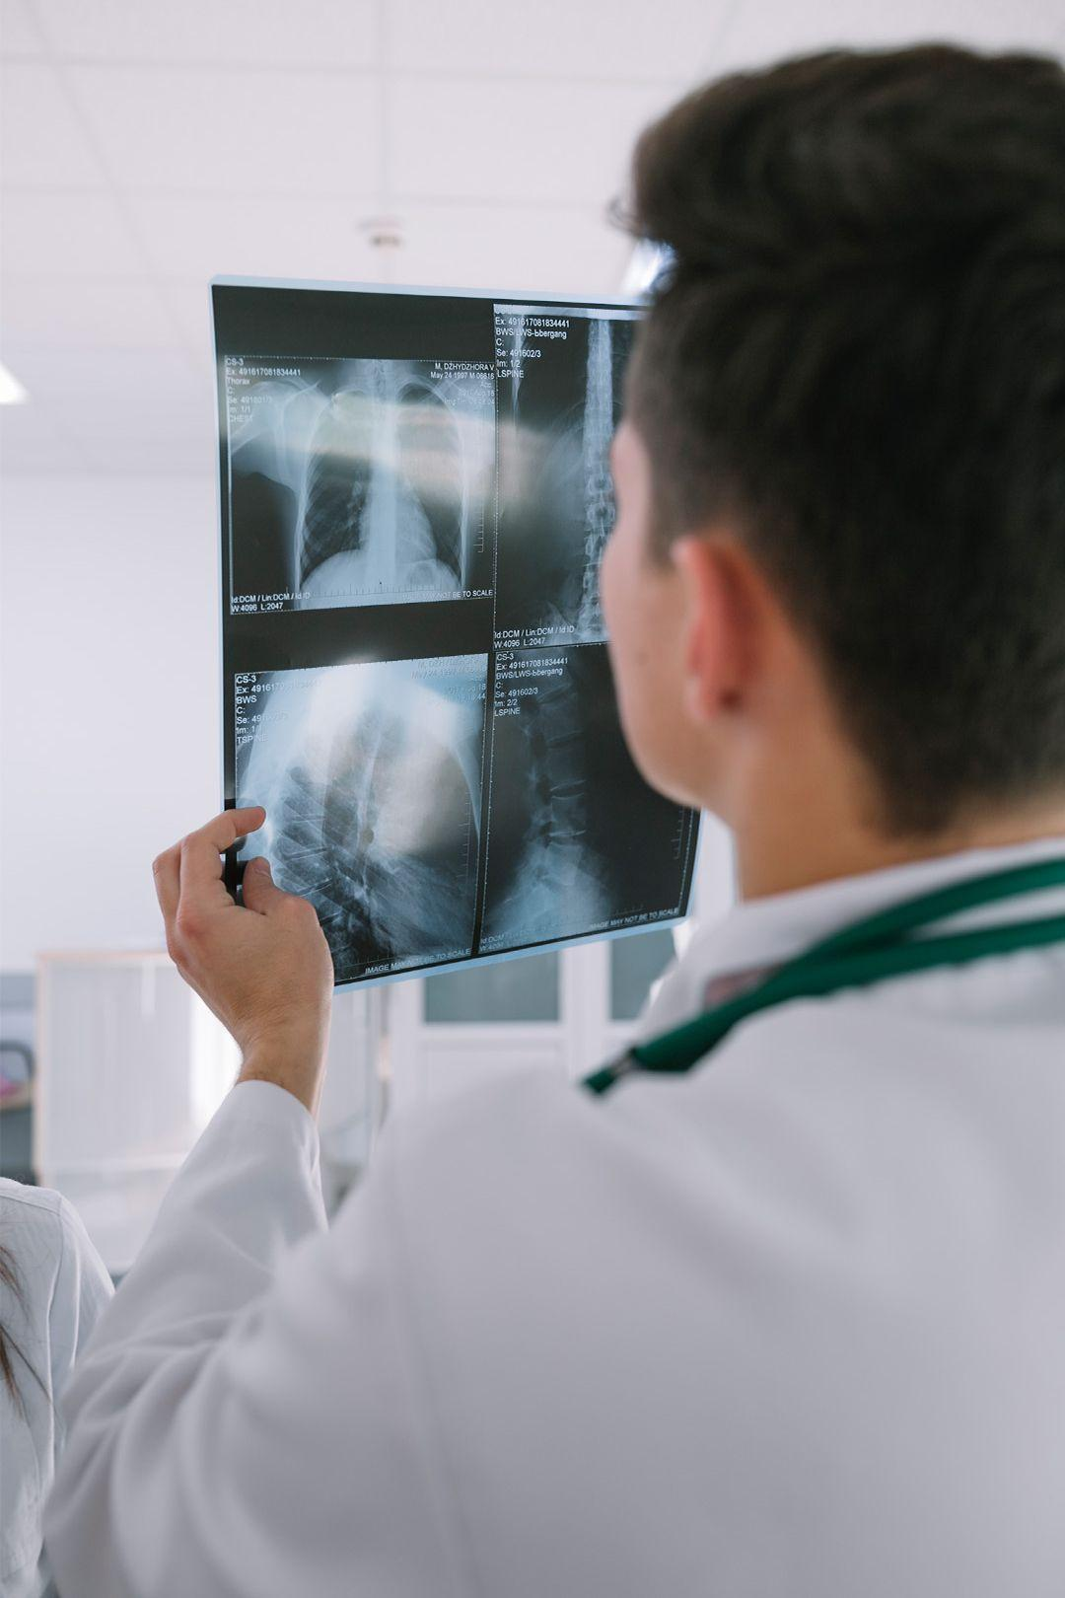
01
Problem

Slide 4
Problem Definition
Radiologists in the U.S. perform on average over 70 million chest X-rays each year.
Cost for imaging and professional reading/interpretation is very high
In developing regions, These areas often don’t have the resources to fully support their healthcare systems or to properly train new radiologists.

Slide 5
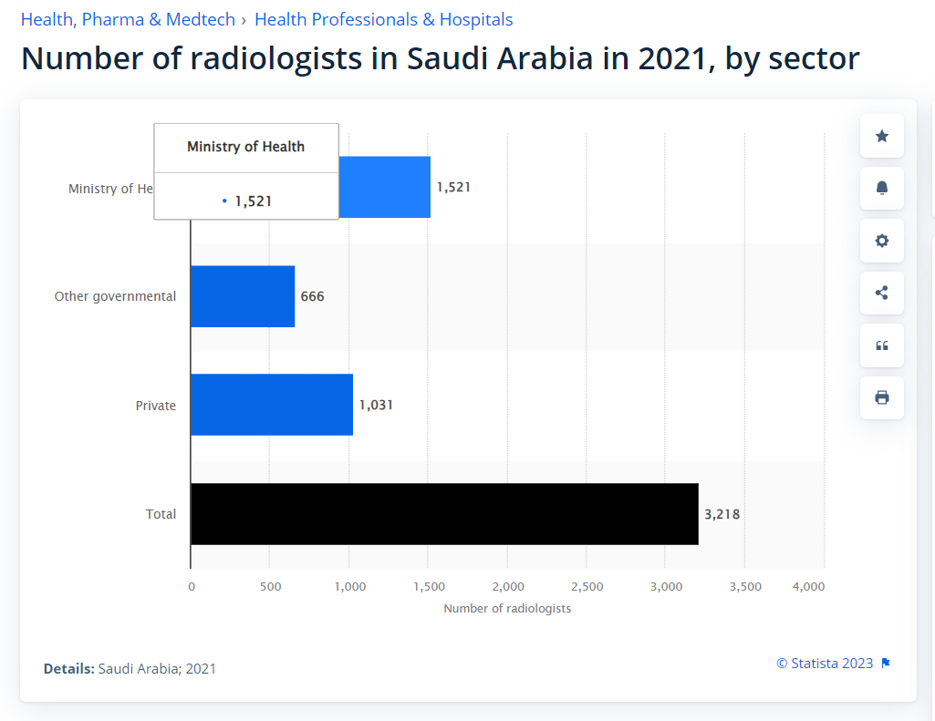
02
Motivation

Slide 6
Motivation
Shorten the time it takes for radiologists to diagnose patients
generate reports on a large number of chest X-rays.
Many X-rays are waiting in queue, and the more serious cases need to be examined first.
X-ray may have noise so the clearer x-ray the more accurate result.

Slide 7
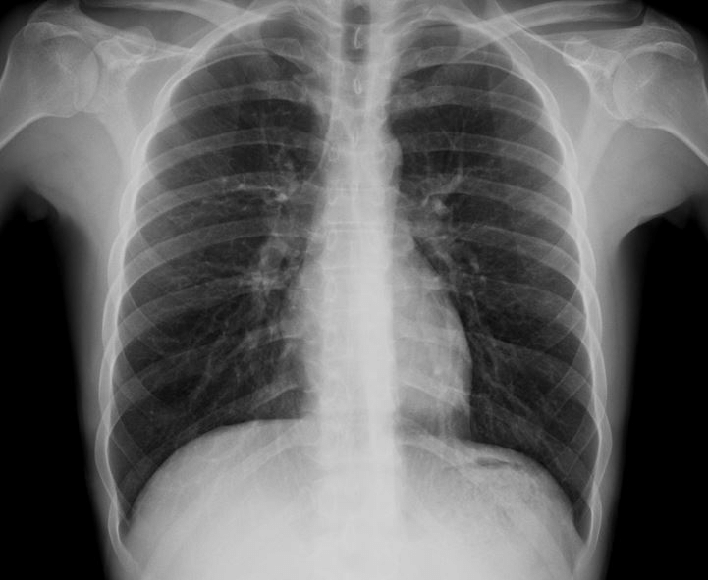
03
Market

Slide 8
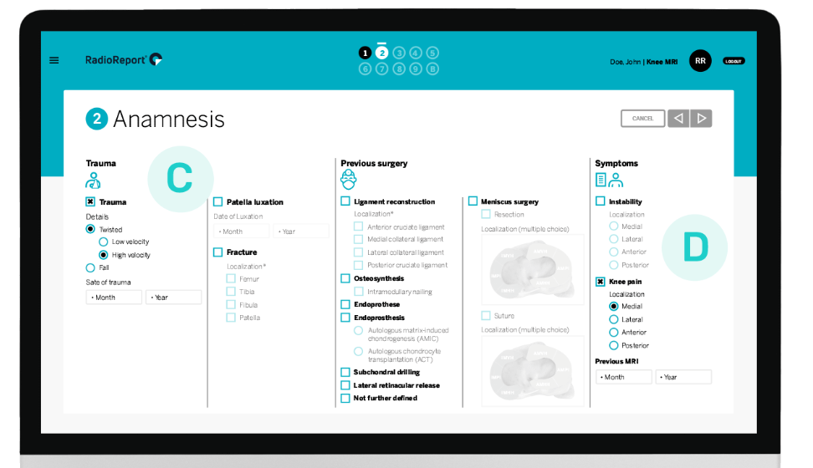
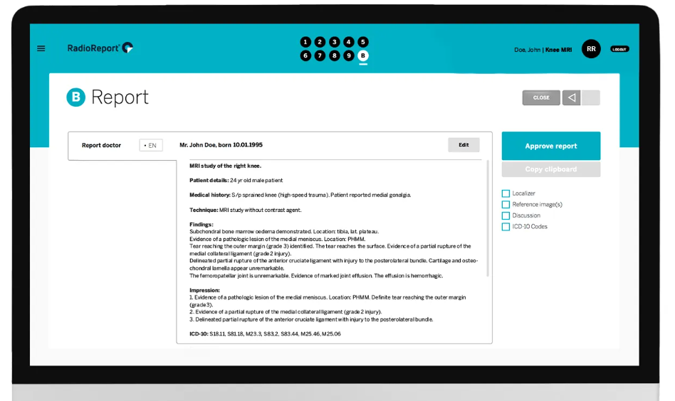
Market Solution
Radio Report → Automation Tool
The software guides you like a virtual
interview to the final report
Notes:
https://radioreport.com/
https://www.ischool.berkeley.edu/projects/2023/vital-smart-sentence-completion-tool-chest-x-ray-reporting

Slide 9
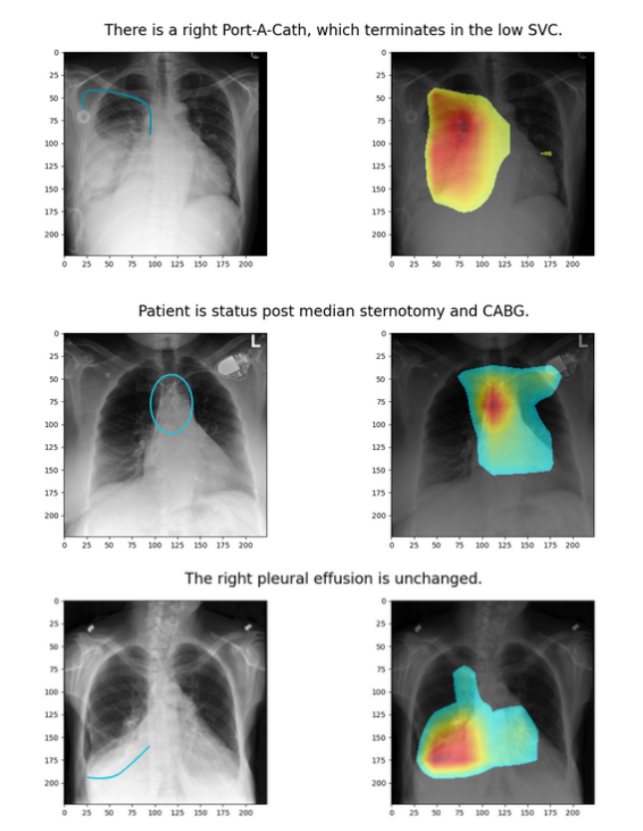
Market Solution
ViTAL → Tool ………………………. readdddddddddd
Notes:
https://radioreport.com/
https://www.ischool.berkeley.edu/projects/2023/vital-smart-sentence-completion-tool-chest-x-ray-reporting

Slide 10
04
Our Tool

Slide 11
Our Solution
The project is an AI solution to automatically diagnose chest x-rays:
denoising the image
detecting anatomical regions and diseases in each region
Generating a full medical report.

Slide 12
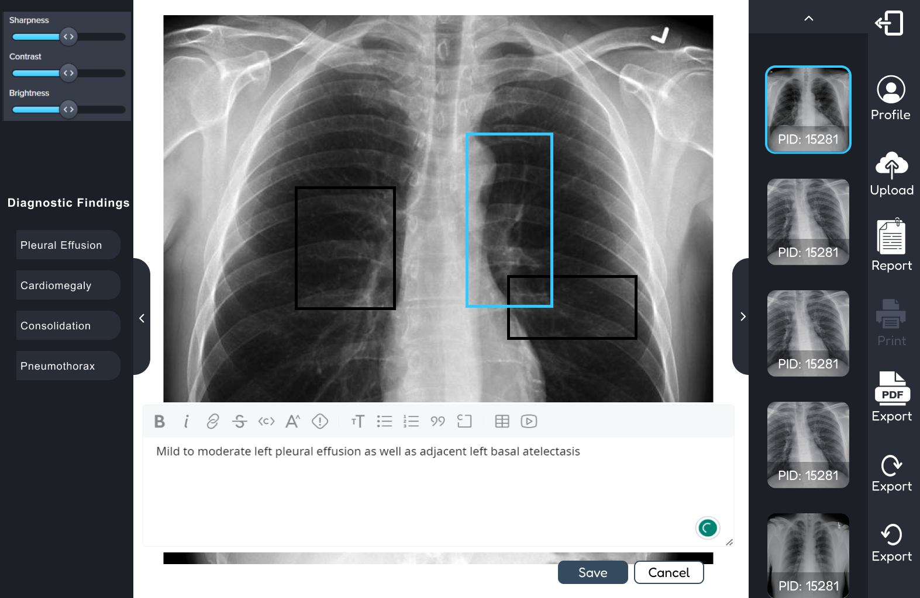
Our Solution

Slide 13
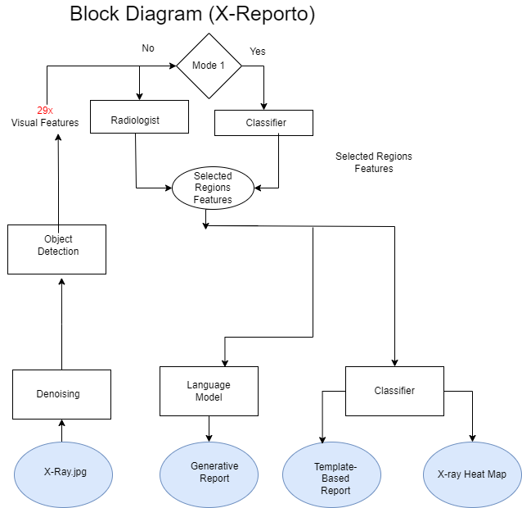

Slide 14
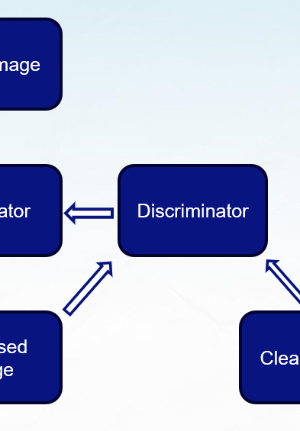
Denoiser
Remove device noises occurring while generating X-rays.
Distinguish between noisy image and clean image.
Differentiate between noise and relevant medical information.
GANs - Autoencoders.

Slide 15
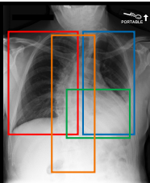
Region Detector
Detect anatomical Regions in chest in order to generate corresponding line in report on it’s abnormal regions.
Faster R-CNN – Yolov5

Slide 16
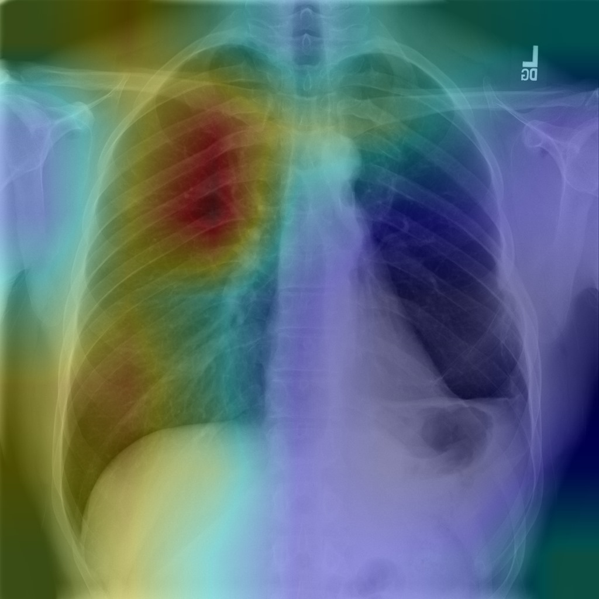
Multilabel Classifier
Classify each region if it’s abnormal
Detect possible diseases in each abnormal region
Generate heatmap for disease location.

Slide 17
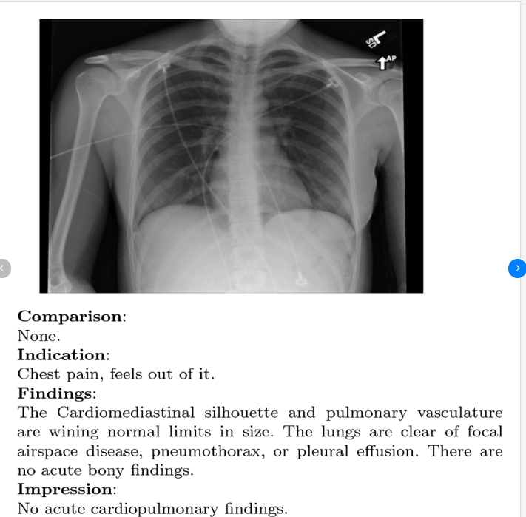
Report Generator
Generate full medical report that truly describes X-Ray image.
Rule-based & Generative AI Approaches
GPT2 – BERT

Slide 18
Workload
 | Ahmed Sabry | Ahmed Hosny | Basma Hatem | Zeinab Moawad
Denoiser | 0% | 0% | 0% | 0%
Region Detector | 0% | 0% | 0% | 0%
Multilabel Classifier | 0% | 0% | 0% | 0%
Report Generator | 0% | 0% | 0% | 0%
Integration | 25% | 25% | 25% | 25%

Slide 19

TIMELINE
Idea
Research
Implement
Evaluate
Integrate
Deploy

Slide 20
Noisy Image
Generator
Discriminator
Denoised Image
Clean Image

Slide 21
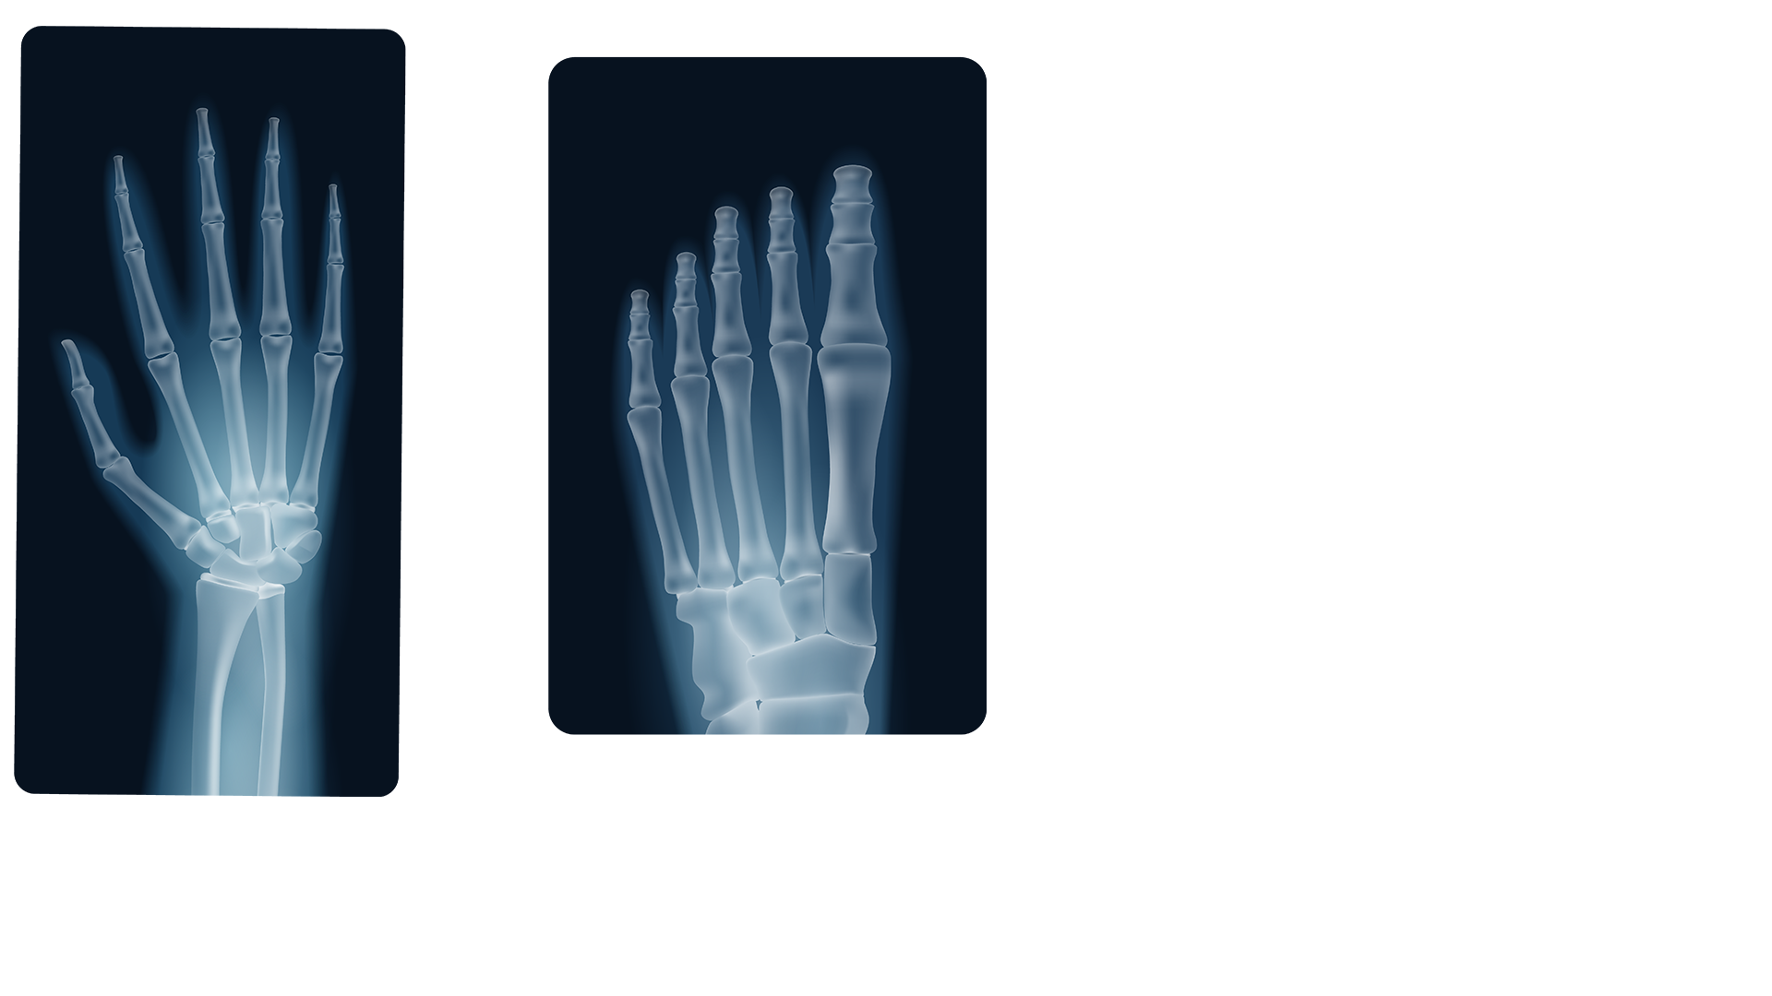
THANKS
ANY QUESTIONS?

Slide 22
Instructions for use
If you have a free account, in order to use this template, you must credit Slidesgo by keeping the Thanks slide. Please refer to the next slide to read the instructions for premium users.
As a Free user, you are allowed to:
Modify this template.
Use it for both personal and commercial projects.
You are not allowed to:
Sublicense, sell or rent any of Slidesgo Content (or a modified version of Slidesgo Content).
Distribute Slidesgo Content unless it has been expressly authorized by Slidesgo.
Include Slidesgo Content in an online or offline database or file.
Offer Slidesgo templates (or modified versions of Slidesgo templates) for download.
Acquire the copyright of Slidesgo Content.
For more information about editing slides, please read our FAQs or visit our blog:
https://slidesgo.com/faqs and https://slidesgo.com/slidesgo-school

Slide 23
Instructions for use (premium users)
As a Premium user, you can use this template without attributing Slidesgo or keeping the "Thanks" slide.
You are allowed to:
Modify this template.
Use it for both personal and commercial purposes.
Hide or delete the “Thanks” slide and the mention to Slidesgo in the credits.
Share this template in an editable format with people who are not part of your team.
You are not allowed to:
Sublicense, sell or rent this Slidesgo Template (or a modified version of this Slidesgo Template).
Distribute this Slidesgo Template (or a modified version of this Slidesgo Template) or include it in a database or in any other product or service that offers downloadable images, icons or presentations that may be subject to distribution or resale.
Use any of the elements that are part of this Slidesgo Template in an isolated and separated way from this Template.
Register any of the elements that are part of this template as a trademark or logo, or register it as a work in an intellectual property registry or similar.
For more information about editing slides, please read our FAQs or visit our blog:
https://slidesgo.com/faqs and https://slidesgo.com/slidesgo-school

Slide 24
Fonts & colors used
This presentation has been made using the following fonts:
Catamaran
(https://fonts.google.com/specimen/Catamaran)
Archivo
(https://fonts.google.com/specimen/Archivo)
#0f2947
#ffffff
#c8e6f3
#cdd8e0
#a3b1bd
#2a4964
#081480

Slide 25





Storyset
Create your Story with our illustrated concepts. Choose the style you like the most, edit its colors, pick the background and layers you want to show and bring them to life with the animator panel! It will boost your presentation. Check out how it works.
Pana
Amico
Bro
Rafiki
Cuate

Slide 26
Use our editable graphic resources...
You can easily resize these resources without losing quality. To change the color, just ungroup the resource and click on the object you want to change. Then, click on the paint bucket and select the color you want. Group the resource again when you’re done. You can also look for more infographics on Slidesgo.

Slide 29
JANUARY
FEBRUARY
MARCH
APRIL
MAY
JUNE
PHASE 1
Task 1
Task 2
PHASE 2
Task 1
Task 2
JANUARY
FEBRUARY
MARCH
APRIL
PHASE 1
Task 1
Task 2

Slide 32
...and our sets of editable icons
You can resize these icons without losing quality.
You can change the stroke and fill color; just select the icon and click on the paint bucket/pen.
In Google Slides, you can also use Flaticon’s extension, allowing you to customize and add even more icons.

Slide 33
Educational Icons
Medical Icons

Slide 34
Business Icons
Teamwork Icons

Slide 35
Help & Support Icons
Avatar Icons

Slide 36
Creative Process Icons
Performing Arts Icons

Slide 37
Nature Icons

Slide 38
SEO & Marketing Icons

Slide 39


